Slide 1



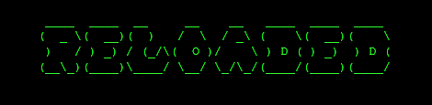

Greed Reloaded.exe
> Done By:
Sri Sham
Jeffrey Low
Glence Low
Gary Goh

Slide 2

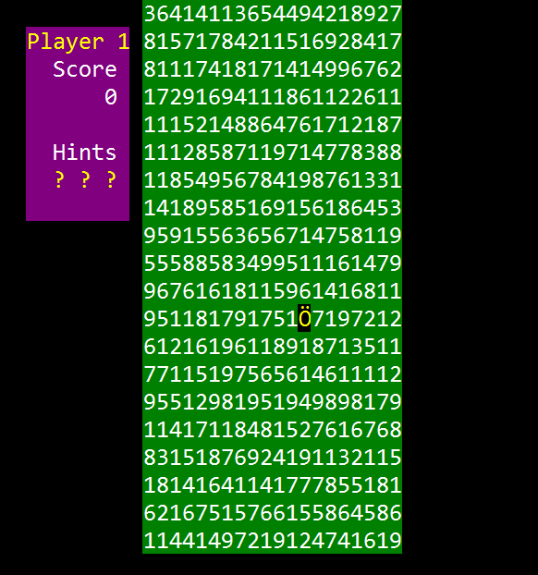
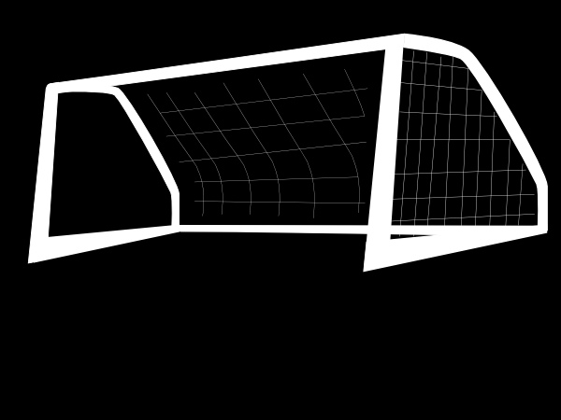
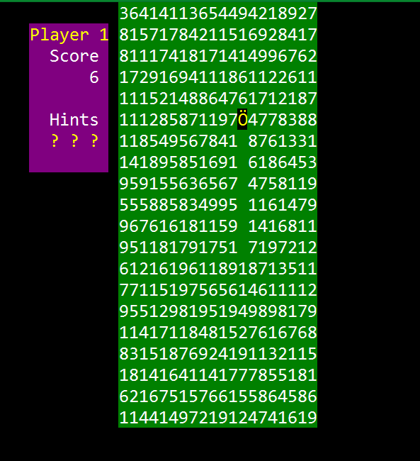
Greed Reloaded.exe
greedReloaded = eating numbers and the amount you move will depend on the number and direction you are facing
As many points as possible

Slide 3

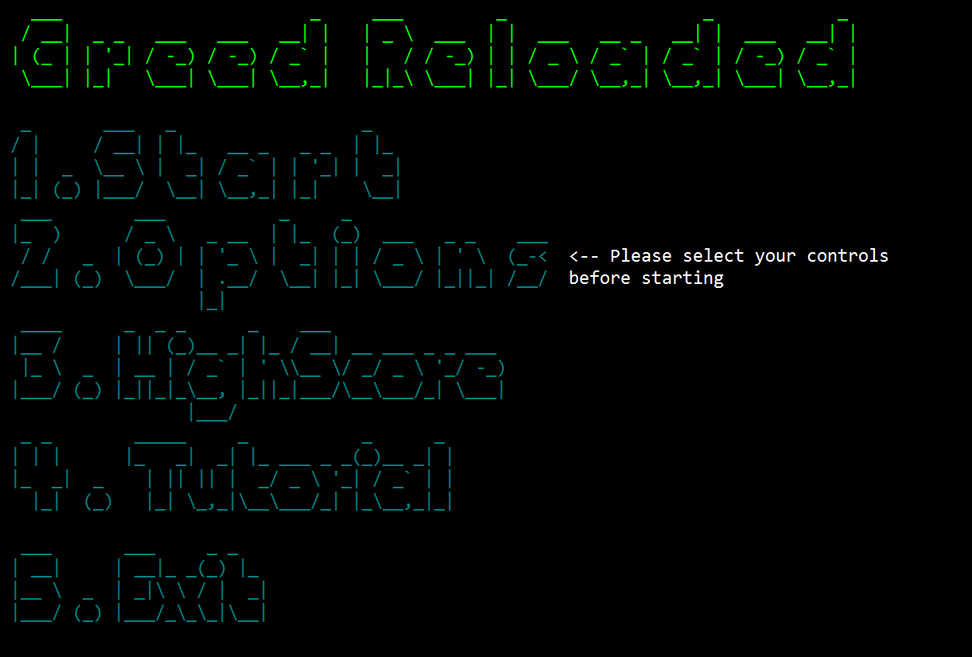
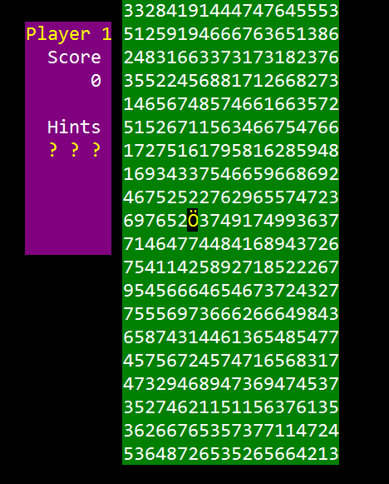
Greed Reloaded.exe

Slide 4

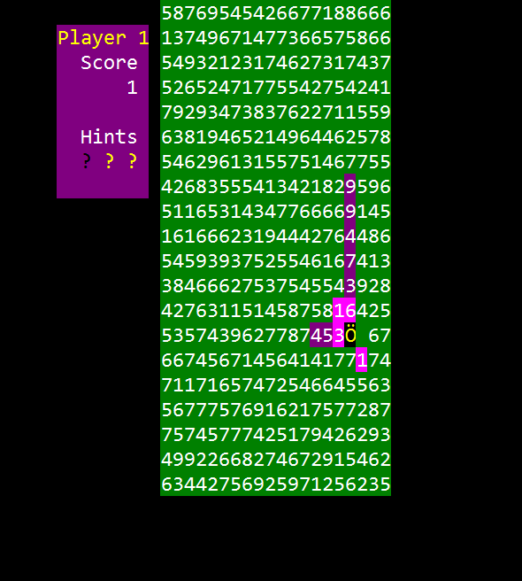
Greed Reloaded.exe
Hinting System by Gary Goh
Movement by Sri Sham
Players & Player Struct by Gary Goh
Board Generation by Sri Sham

Slide 5

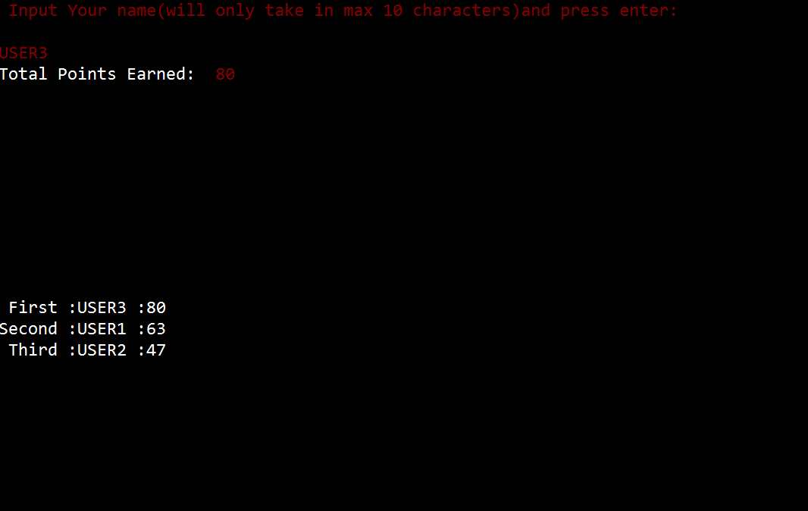
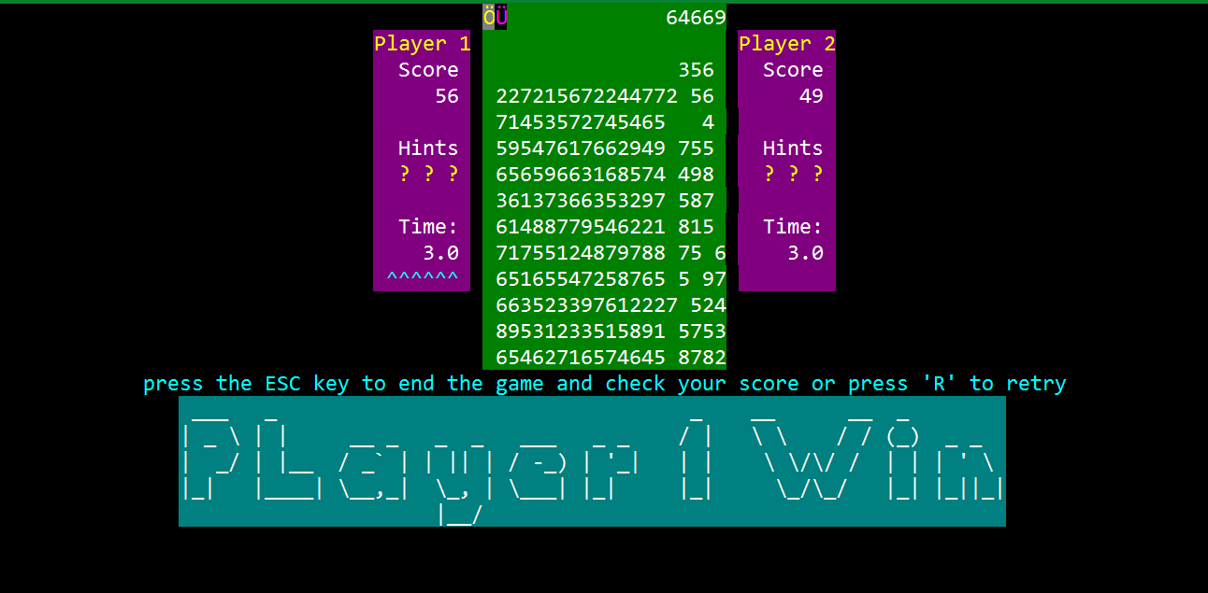
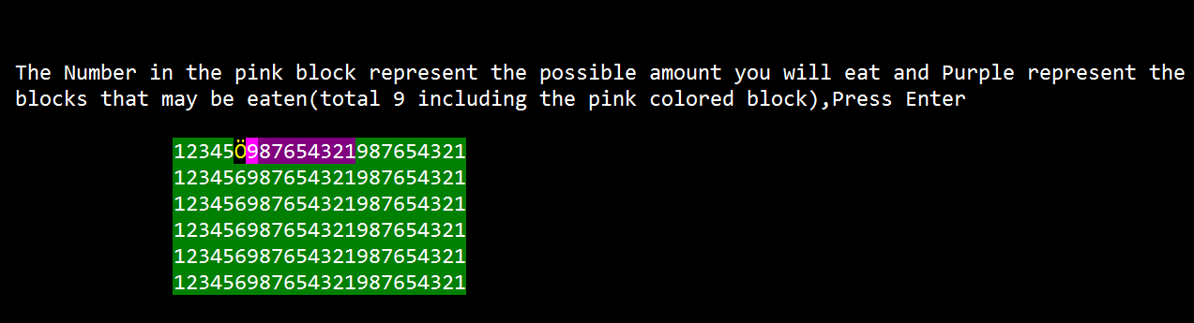
Greed Reloaded.exe
Highscore by Jeffrey Low
Chances by Glence Low
Tutorial by Jeffrey Low
Time mode by Glence Low

Slide 6





Greed Reloaded.exe
Lots of potential replay-ability
For casual play and competitive play
Easy to pick-up , Hard to master
Uniquely Strategic

Slide 7

Greed Reloaded.exe

